Slide 1
Repeat + Calculate of Measures for Association
Homework H3.5
Robin Beer – Abdulkarim Joukhadar

Slide 2
Measures for Association
Support
Confidence
Lift
Percentage of how often an association appears in the whole dataset
How often the rule is found to be true
Ratio of how often the association occurs compared to if the values were independent

Slide 3




Association Rules $X⇒Y$
Support
Confidence
Lift
$$Support=\frac{frq \left(X,Y\right)}{N}$$
$$Confidence=\frac{frq \left(X,Y\right)}{frq \left(X\right)}$$
$$Lift=\frac{Support}{Support\left(X\right)×Support\left(Y\right)}$$

Slide 4





Item sets of a shopping basket
1 | 2 | 3 | 4 | 5 | 6 | 7 | 8

Slide 5
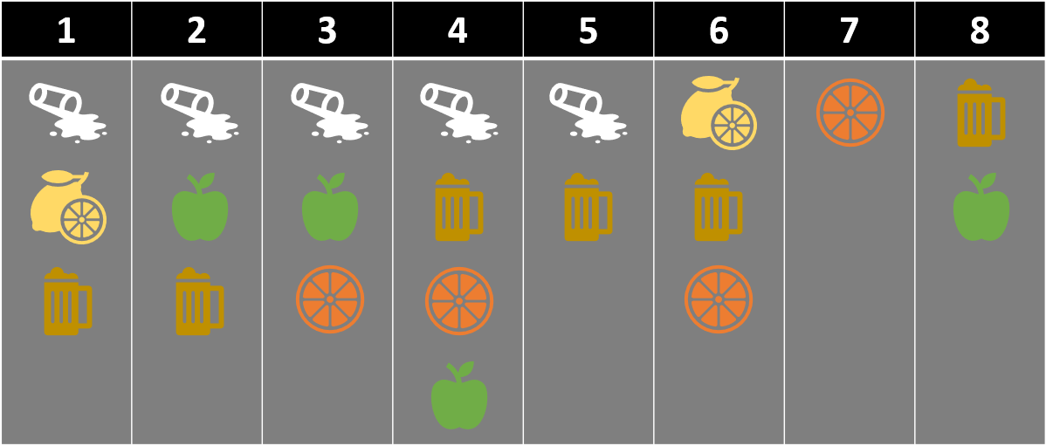



1. What is the support of the item set {Bier, Orangensaft}?
$$Support=\frac{frq \left(X,Y\right)}{N}$$
$$Support=\frac{frq \left(Bier, Orangensaft\right)}{N}$$
$$Support=\frac{2}{8}=\frac{1}{4}=25\%$$

Slide 6



2. What is the confidence of {Bier}➔{Milch}?
$$Confidence=\frac{frq \left(X,Y\right)}{frq \left(X\right)}$$
$$Confidence=\frac{frq \left(Bier,Milch\right)}{frq \left(Bier\right)}$$
$$Confidence=\frac{4}{6}=\frac{2}{3}=66,67\%$$

Slide 7
3. Which association rules have support and confidence of at least 50%?
Frequencies:
Milch: 5
Limonade: 2
Bier: 6
Apfelsaft: 4
Orangensaft: 4

Slide 8
3. Which association rules have support and confidence of at least 50%?
X/Y
 | X | S = 1/8 C = 1/5 | S = 1/2 C = 4/5 | S = 3/8 C = 5/8 | S = 1/4 C = 2/5
 | S = 1/8 C = 1/2 | X | S = 1/4 C = 1 | 0 | S = 1/8 C = 1/2
 | S = 1/2 C = 2/3 | S = 1/4 C = 1/3 | X | S = 3/8 C = 1/2 | S = 1/4 C = 1/3
 | S = 3/8 C = 3/4 | 0 | S = 3/8 C = 3/4 | X | S = 1/4 C = 1/2
 | S = 1/4 C = 1/2 | S = 1/8 C = 1/4 | S = 1/4 C = 1/2 | S = 1/4 C = 1/2 | X

Slide 9
X/Y
 | X | X | S = 1/8 C = 1 | 0 | 0
 | X | S = 1/8 C = 1/4 | X | S = 1/4 C = 1/2 | S = 1/8 C = 1/4
 | X | 0 | S = 1/4 C = 2/3 | X | S = 1/4 C = 2/3
 | X | 0 | S = 1/8 C = 1/2 | S = 1/4 C = 1 | X
 | S = 1/8 C = 1/2 | X | X | 0 | S = 1/8 C = 1/2
 | - | X | - | X | -
 | 0 | X | S = 1/8 C = 1 | 0 | X
 | S = 1/4 C = 2/3 | 0 | X | X | S = 1/8 C = 1/3
 | S = 1/8 C = 1/2 | S = 1/8 C = 1/2 | X | S = 1/8 C = 1/2 | X
 | S = 1/4 C = 1 | 0 | S = 1/8 C = 1/2 | X | X

Slide 10
Vielen Dank für die Aufmerksamkeit!

